Slide 1
A Program for Photographers Event
Pavan Reddy Mamidi

Slide 2
Introduction
XYZ is a company based in Toronto for organizing events. Currently, they are working on a project which will organize an event for seven days for a group of photographers from all over the world.
The company must determine a good program, including a hotel for the residence, a hall for meetings, places to visit, places of shopping, restaurants and cafes to eat and drink.
The company must make a list of places in Toronto, including the nearest restaurants, cafes and shopping stores for each place. And it has to provide a map in case the photographer don’t use digital applications for some reason.
Notes:
Insert a map of your country.

Slide 3
Objective
List and visualize all hotels near Toronto and choose the hotel which has the same Postal code with the event space
List all the parks near Toronto
List all the Restaurants near Toronto
List all the Cafeteria near Toronto
List all the Shopping stores near Toronto
Generate maps to visualize venues and know how they cluster together
Notes:
Insert a picture of one of the geographic features of your country.

Slide 4
Data Section
For this project we need the following data:
Toronto City data that contains list Boroughs, Neighbourhoods along with their latitude and longitude.
Hotels in each neighbourhood of Toronto City.
Parks in each neighbourhood of Toronto City.
Restaurants in each neighbourhood of Toronto City.
Shopping stores in each neighbourhood of Toronto City.
Cafeteria in each neighbourhood of Toronto City.
Notes:
Insert a picture illustrating a season in your country.

Slide 5
Methodology
We begin by importing required libraries like Pandas, NumPy etc, and also by collecting the Toronto city data.
After that, we define foursquare credentials and also define the city and get its latitude and longitude.
Search for the features below and get them transformed into a data frame
Clean features data frame by unnecessary columns, rows with none values, and rows where the category is not park.
Hotels
Parks
Restaurants
Cafeteria
Shopping stores
Notes:
Insert a picture of an animal and or plant found in your country.

Slide 6
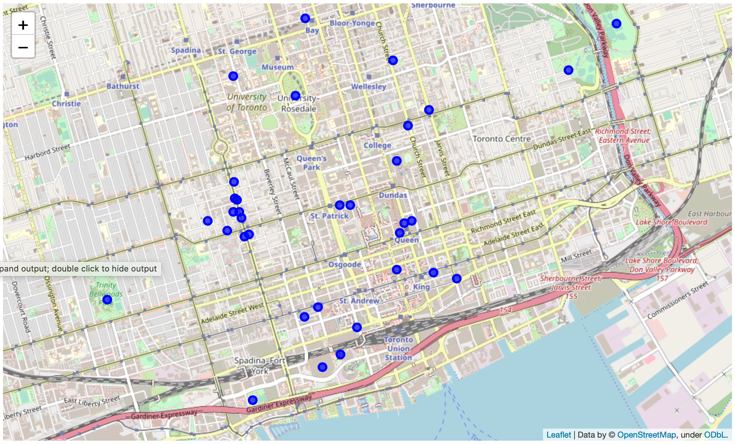
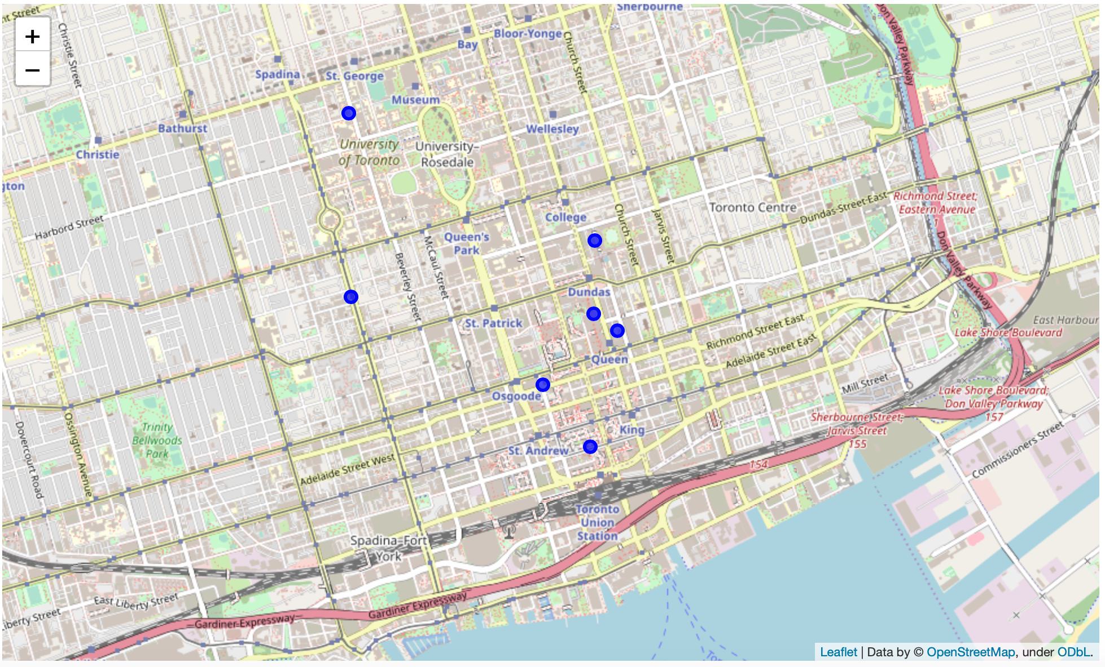

Slide 7

Conclusion
Sheraton Centre Toronto Hotel is the hotel which is near postal code of event space and it is selected, and parks, restaurants, cafeteria, shopping stores around this hotel are shown in the Jupyter Notebook.
Notes:
Add key points in the history of your country to the timeline.

